Slide 1
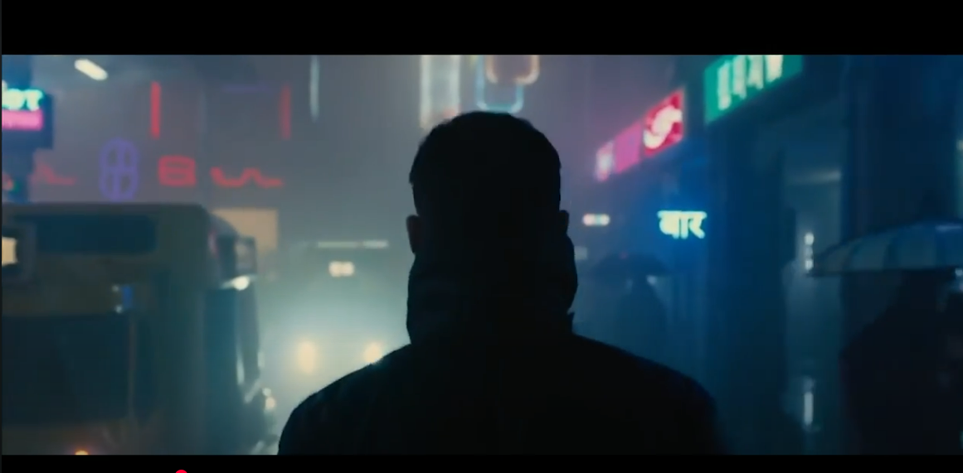
Design Analysis:
The color contrast between the foreground and background makes it easier to distinguish between the main object (character in the centre)
The contrast of sharpness (sharp foreground vs blurry background) also facilitates the understanding of the imagery
The positioning of the main object (overall layout) in the centre draws the viewer’s attention into 1 focus point

Slide 2
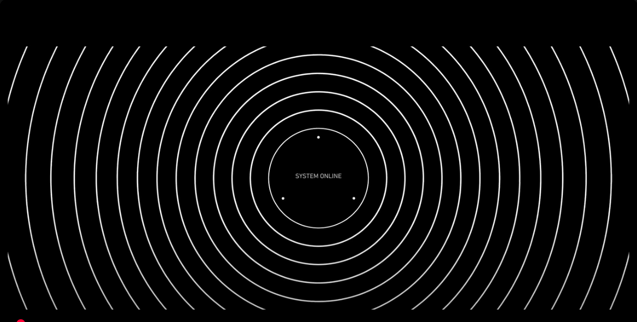
Design Analysis:
Repetition and proximity of the circular lines create a link and convey the uniqueness of the object
Contrasted color for the lines and the background (black vs white)
Alignment of the text ‘SYSTEM ONLINE’ in the centre (both horizontally and vertically) to draw the viewer’s attention and create a balanced look

Slide 3
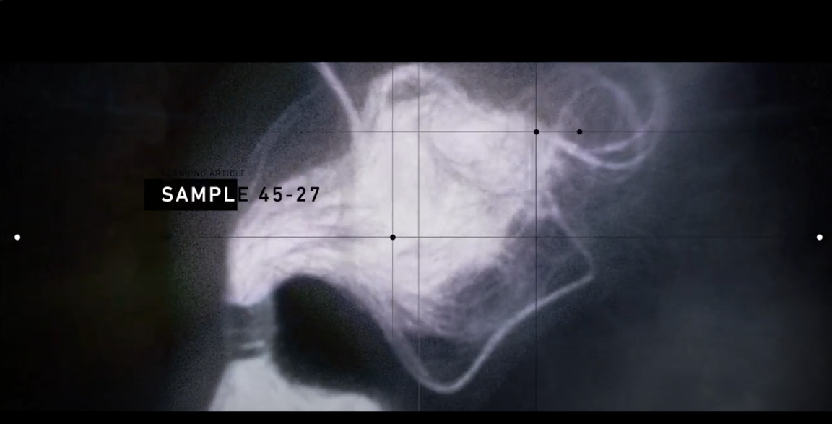
Design Analysis:
Blur effect in the background shapes creates a contrast and shows clear distinction between foreground and background
Alignment of the text to the left
Text color contrast (white on black background and black on white background) for better readability
Repetition of the same font to create a more unified look and enhance consistency of the design

Slide 4
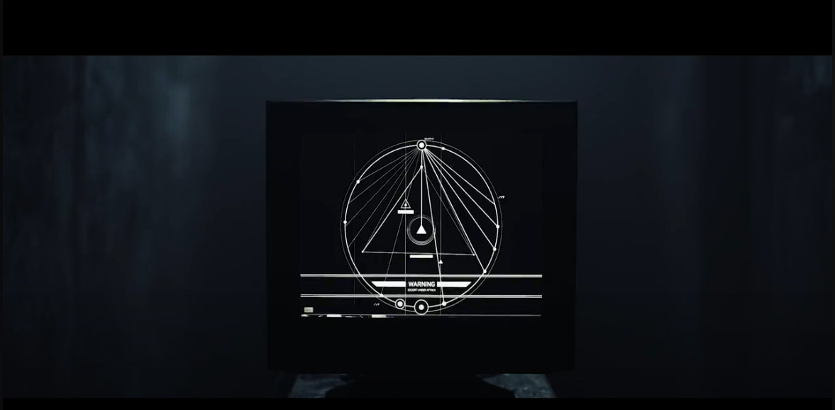
Design Analysis:
Background blur effect to create contrast between foreground and background
Positioning of the main visual in the center to create a focus point
Contrasted color between lines and background (white vs background) for better scannability by the viewer eye
Repetition of the lines inside the circle

Slide 5
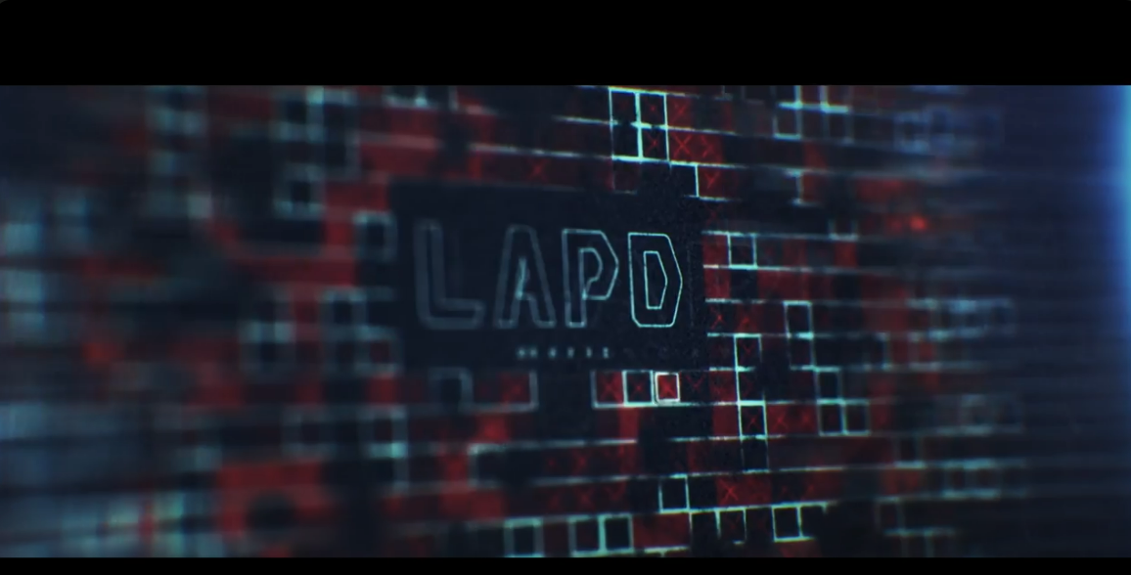
Design Analysis:
Blur effect in the background shapes creates a contrast and shows clear distinction between foreground and background
Positioning of the main object in the centre to draw the view’s attention
Contrast between text background color and outline color for better readability and visibility
Use of color harmony by merging 2 opposite colors in the color wheel (red hue vs blue hue), creating a clear contrast that accentuates the design

